Slide 1

SIEC BA5
3 MARCH 2023
MENDANA HOTEL

Slide 2
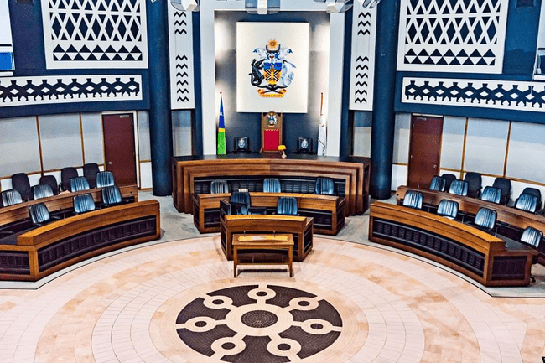
TASKFORCE ON ELECTORAL REFORM PRESENTATION TO THE SOLOMON ISLANDS CHAMBER OF COMMERCE AND INDUSTRY (SICCI)

Slide 3
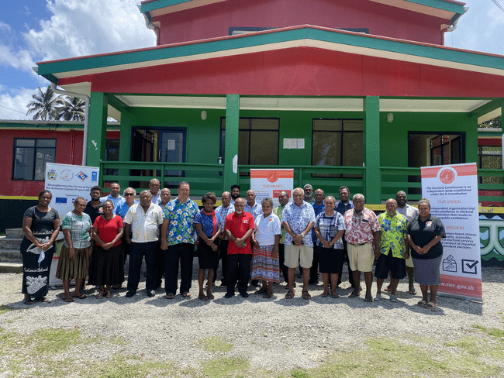
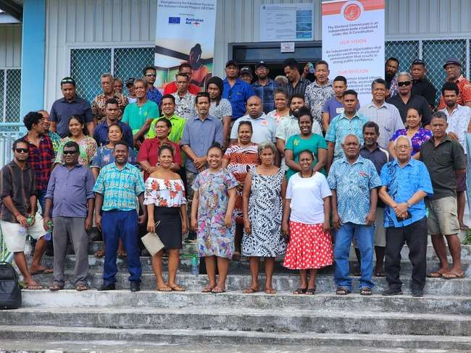
ELECTORAL REFORMS
PRESENTATION TO
SICCI MEMBERS
BY TASKFORCE ON ELECTORAL REFORMS
Friday 3rd March 2023

Slide 4
PRESENTATION OUTLINE
Synchronization of all Elections for all levels of governance
Continuous Voter Registration
Out of Constituency Voting

Slide 5
Synchronization of all Elections for all levels of Governance
Background
Resolution 4 - “To align the Provincial and Honiara City Council Elections with National Elections”.
Provincial, Honiara City and National elections are a costly exercise that involves an overlapping of many activities, such as voter registration. Given the potential changes to the National election system with the introduction of the Political Parties Integrity Bill 2013, the Premiers support a move to align Provincial and Honiara City elections with National elections to save money and prevent duplication of services.”
Essence of Resolution – i) Cost saving approach and prevention of duplication of services; ii) Successive Premier’s conferences since 2013 seemed supportive of this concept.

Slide 6
Background to Synchronization – cont
Goal 3 of the ERSF talks about “Efficient and effective conduct of elections for both provincial assemblies and national parliament” in 2023.”
Outcome 1 makes reference to “The life of the 9 provincial assemblies aligned to be dissolved together with the national parliament.”
In 2019, the Electoral Commission decided to trial the possibility of holding simultaneous elections at a small scale in East Makira Constituency.
Another trial was conducted in West Kwaio Constituency last year, 2022. Both trials were conducted without any major problems.

Slide 7
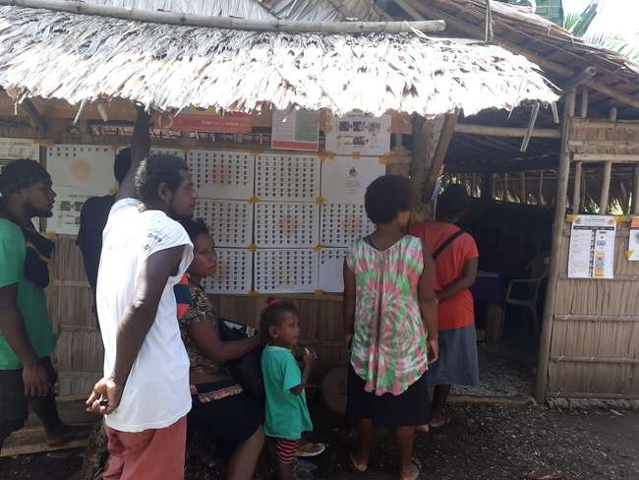
Simultaneous Election Trialed 2019 East Makira

Slide 8
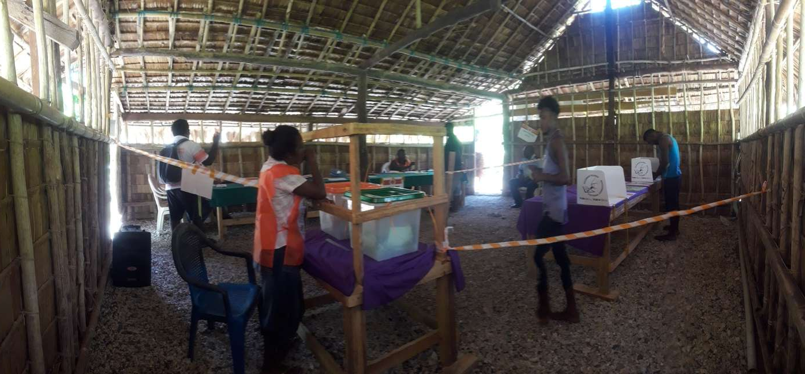
Simultaneous Election Trailed 2019 East Makira
Notes:
1.Inside of the Polling booth:
One polling station, with two Ballot Boxes – one for National Elections (Orange) and the Other for Provincial Election (Green).
The voter was given two ballot papers (with different colours, (one for the parliamentary by-election and the other for Provincial one), before voters cast their vote.
2. Summary experiences, obvious key benefits were;
i) One budget for all elections & one planning process from SIEO team
ii) Substantial savings in both budget for administrative and logistic & mobilisation costs, especially in our geographically scattered islands,
ii) Good and efficient use of limited resources and manpower etc.
iv) Voters understand the process easily, - instructed through SIEO awareness to mark their choice of candidate from the two ballot papers. Before they cast their votes.
3. This trial arrangement worked out quite well and the elections was held successfully in 2019. Of course this is a result of good co-operation between MPGIS and SIEO Team (it involved various administrative amendments made to the Provincial Government (Election) Regulations 2010, so that these regulations are aligned with provisions of the Electoral Act 2018.
In 2021 this concept was also trialled for the South Choiseul constituency by-election and the Provincial by-elections for East Choiseul ward 16 and ward 16 (Tikopia and Anuta) in Temotu Province, though a slightly different context.
For the Next Slides – I will ask Philip Kanairara, to come and take us through them.

Slide 9
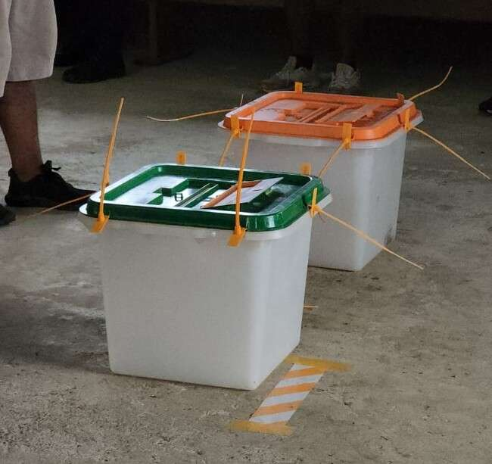
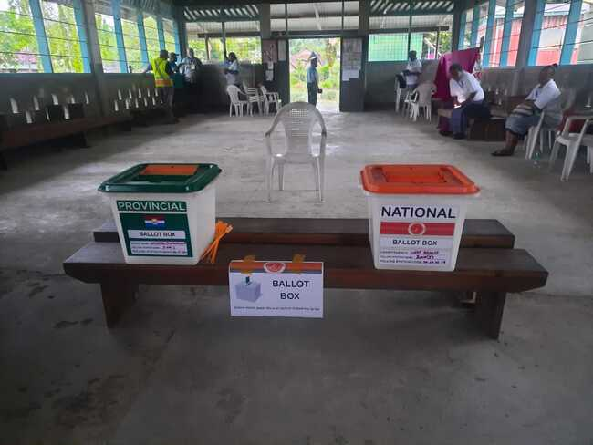
Simultaneous Election Trailed in West Kwaio By-election 2022

Slide 10
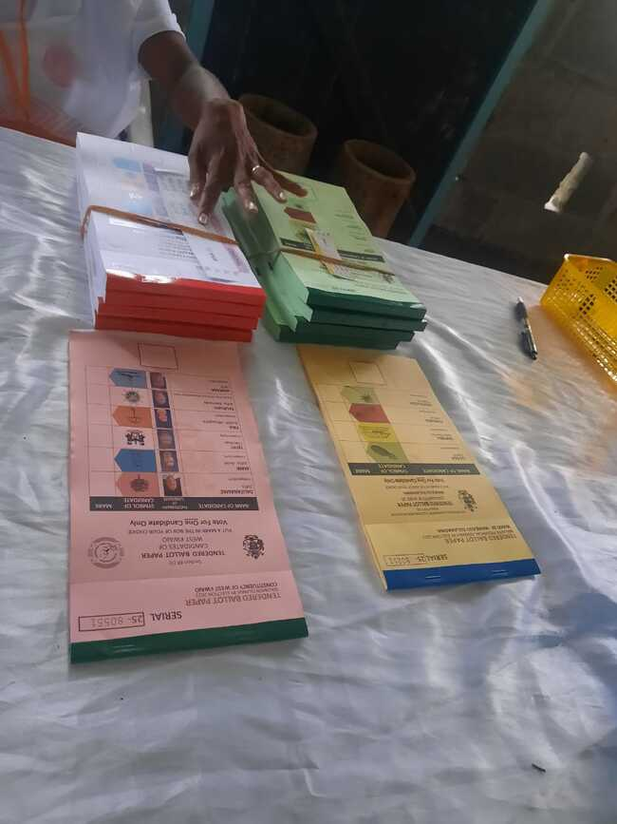
Ballot Papers

Slide 11
Advantages and Disadvantages of simultaneous elections
Advantages:
  Significant reduction of logistics and administrative expenses due to one joint election instead of two separate elections;
  Political parties making presence at the provincial and council level;
  Reduction of political party expenses if they are to involve in provincial/council elections;
  Higher turn out for provincial elections;
  Minimised work disruption for civil servants;
  Reduce potential voter fatigue

Slide 12
Disadvantages
Relegation of provincial issues in favour of national issues during campaigns but doubtful as quality education, good medical facilities, employment creation and opportunities remain important issues at all levels;
The question of the Electoral Commission’s capacity to conduct such a massive scale election;
Reduction of job opportunities;
Arbitrary shortening or extension of provincial/Council if no proper consultations are conducted.
Lack of space for counting Stations especially in the Provinces (Operational Issue)
Notes:
Point 2 – operational challenge - counting challenges, Malaita has 14 constituencies and 33 wards. Identify 47 venues for the counting in Auki will be a challenge. If to be countered at the constituencies – police constraints will be a problem. Those are the challenges but the Commission is prepared to deliver that election promise once the necessary laws are passed to implement the idea of simultaneous elections.

Slide 13
Synchronize Election Date?
How to achieve?
Need one time extension or shortening of existing tenures of either National Parliament or provincial/council level or delay the election dates for the Provincial Assemblies where permitted by law.
Peg the simultaneous election cycle to the Parliament since parliament elections is for the whole country.
Also amending the Constitutional provision on parliamentary tenure requires 2/3 majority while amending the Provincial Government Act and the City Council Act will just require a simple majority.

Slide 14
Synchronizing Election Date continues
The current Parliament term ends on 31st December 2023 as the result of the Constitution (Amendment) Act 2022. The current SIEC Plan is to have the GG issue the proclamation appointing the date of election on 24th Feb 2024. If use the standard activity timeline of 56 days for parliamentary elections, election day would fall on Wednesday 17 April 2024 – see Annex A on page 11 for details.
17 April 2024 will be the synchronize election day where the provincial assemblies and the Honiara City Council must also have their elections.

Slide 15
So what will happen to ensure elections at all levels are held on 17th April 2024? Options?
1. Amendments to the Provincial Government Act 1997 to allow for one off early dissolution or extending of the life of the Assemblies.
2. Minister of Provincial Government to delay election dates where applicable.
3. Amend the Honiara City Act 1999 to extend the life of the Council to cater for the synchronize election date.

Slide 16
Current Dissolution Dates:
Unless dissolved earlier, the current dissolution dates at all levels are as follows –
National Parliament – 31 DECEMBER 2023
Honiara City Council - 22 May 2023
Provincial Assemblies:
The first 2 Provincial Assemblies listed below will dissolve on 13 December 2026
  Western Province
  Choiseul Province
Notes:
Note here that Minister for Provincial Government had invoke his power under the Provincial Government Act to defer Election for nearly six months as in the Case of Western province and Choiseul Province

Slide 17
Current Dissolution Dates:
The next 6 Provincial assemblies listed below will dissolve on 11 June 2023
Malaita
Central
Rennel and Bellona
Isabel
Temotu
Guadalcanal

Slide 18
Current Dissolution Dates:
Makira-Ulawa Provincial Assembly will dissolve on
11th December 2023
If we are to hold the NEXT Election on the same Day – the Date will be:
Wednesday 17th April 2024

Slide 19
Proposed Extensions or Shortening of Terms
It is evident that Dissolutions Dates for provincial and HCC
NEEDS to be extended for most provinces and HCC. Western and Choiseul Assemblies will need to be shorted.
This is to enable All Election – Provincial Assemblies, HCC and NATIONAL Parliament to fall on the 17th of April 2024
Proposal - HCC and Provincial Assemblies to be dissolved on 31st December 2023 same as National Parliament. They will all have a four months grace period as the National Parliament. Other option is the HCC and Assemblies dissolves on the eve of elections, 16th April 2024.
Notes:
The Question here is whether the Minister invokes power to defer the Election day or an amendment to Provincial Government Act and HCC Act to extend or shorten the life of Assemblies/Council where appropriate.
A sunset amendment to assist in Synchronize the Election Date could be an option.

Slide 20
Proposed Extensions or Shortening of Terms:
No. | PROVINCIAL ASSEMBLY/HCC | END OF CURRENT TERM | APPROX SHORTENING/EXTENSION (Number of Months)
1 | Western | 13 December 2026 | -32
2 | Choiseul | 13 December 2026 | -32
3 | Malaita | 11 June 2023 | + 10
4 | Central | 11 June 2023 | + 10
5 | Rennel and Bellona | 11 June 2023 | + 10
6 | Isabel | 11 June 2023 | + 10

Slide 21
Proposed Extensions or Shortening of Terms or delay of election dates
No. | PROVINCIAL ASSEMBLY/HCC | END OF CURRENT TERM | APPROX SHORTENING/EXTENSION OR DELAY OF ELECTION DATES (Number of Months)
7 | Temotu | 11 June 2023 | + 10
8 | Guadalcanal | 11 June 2023 | + 10
9 | Makira Ulawa | 10 December 2023 | + 4
10 | Honiara City Council | 21 May 2023 | + 10
Notes:
11th June or 12 June

Slide 22
Any examples of where simultaneous election is used? Problems? Challenges?
India, the Philippines, Indonesia, South Africa, Sweden.
Problems/challenges – see disadvantages of synchronization of elections.

Slide 23
Continuous Voter Registration
Currently there is a set time for Registration for those who wants to Change Constituency, those who turn 18 yrs. and wanted to vote.
There is a huge cost to run this activity of Registration before every National General Elections. One activity in an Election life cycle
The idea is to do continuous registration throughout the 4years cycle before the next General Election.
One of the advantage of having continuous registration is that- Snap Elections/by-elections can use a more up-to-date list if such is to happen.

Slide 24
Out of Constituency Voting
New provision s 97A - out of constituencies voting
This would allow voters to vote outside of their constituencies if they meet certain criteria.
Thinking of testing the idea during by-elections so to identify the any issues with it such as costs, capacity of the Electoral Office, etc .
Regulations to be prepared to support this method of voting.
Notes:
Tested in SI first or overseas?.
Technical adviser is in the Country and is working on how this will work out in practice… also to ensure checks and balances are robust to avoid abuses of the out of constituency voting.
Whether it will also happen in 2018 - simultaneous election is already a huge burden but not unsurmountable or impossible.

Slide 25
Conclusion
Holding one day elections is feasible.
Mindful of the challenge of keeping and maintaining the election date synchronized.
(3) Amendments to relevant election laws and use of Ministerial Power to delay election dates are required.
(4) The Electoral Commission will conduct continuous voter registration.
(5) The Electoral Commission has a strong intention to conduct out of constituency voting. There are however a few challenges to be carefully examined before a firm decision is made.

Slide 26
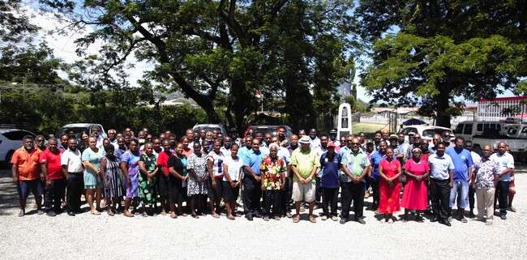
THE END
THANK YOU VERY MUCH FOR LISTENING

